Slide 1

Task 2
Predicting customer buying behaviour
Presented by:
Pooja Bhoi
(2/May/2023)

Slide 2
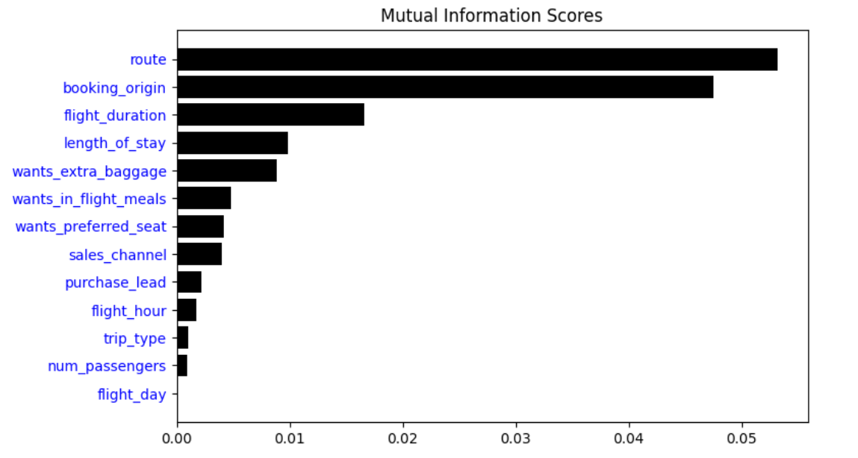
Customer Behavior
After training the dataset with Random Forest Classifier,
ACCURACY: 84.84
AUC score: 0.5425
route
booking_origin
flight_duration
Length_of_stay
wants_extra_baggage
are the top 5 features that influence
Customer buying behavior

